Slide 1

IBM Call for Code 2020 Team: SHARPinnovators Vidhya Natarajan Thirumurugan Mylrajan Sivakumar Mathur Theme: Climate Change / ENERGY SUSTAINABILITY Solution: Green hydrogen from wind energy prediction

Slide 2
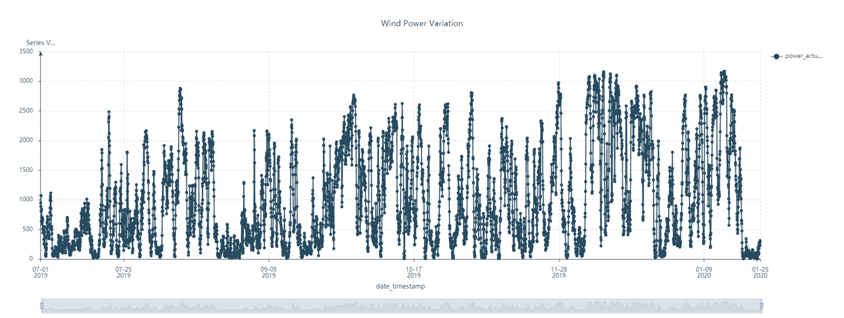
Wind Energy Producer – Problems Faced
Single source of revenue from power Discoms who have financial issues (developing countries)
Highly dependent on government renewable energy policies to ensure profitability
Wind energy is highly variable resulting in grid evacuation problems & instability
Wind power plants have to stop as the power cannot be evacuated in the grid
Wind producers incur balancing cost for variations over forecast in some countries
Graph Source: IBM Watson data Refinery - Data Source: www.eliga.be

Slide 3
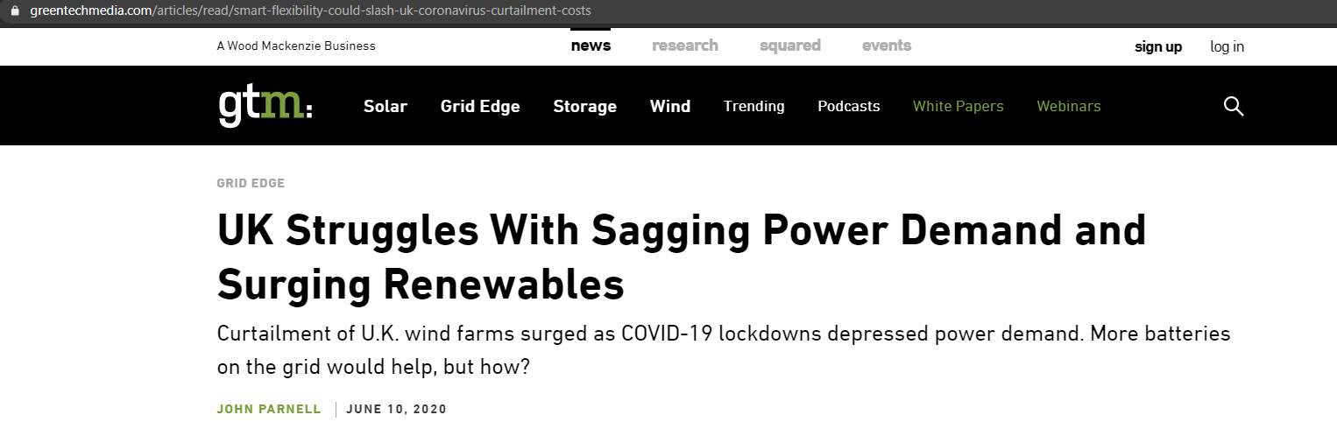
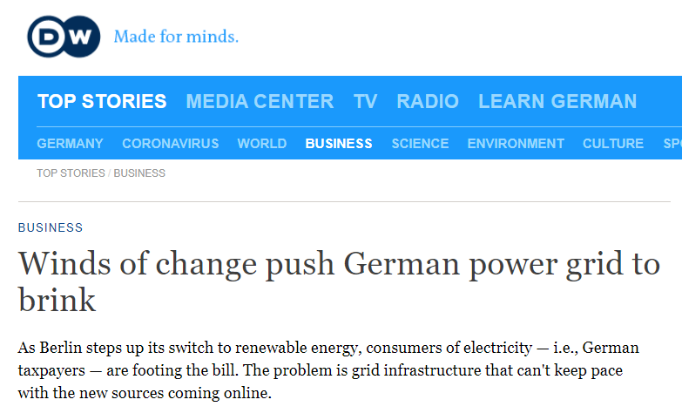
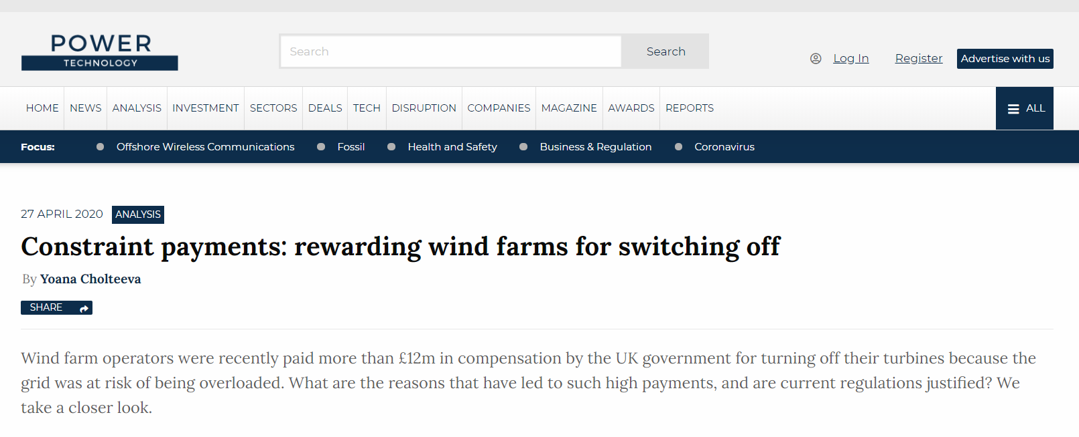
Wind Energy – Current Issues

Slide 4
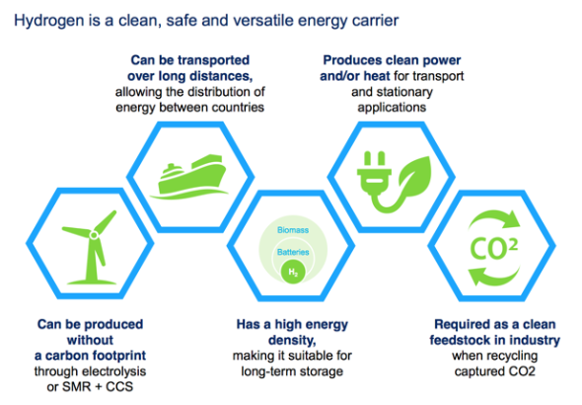
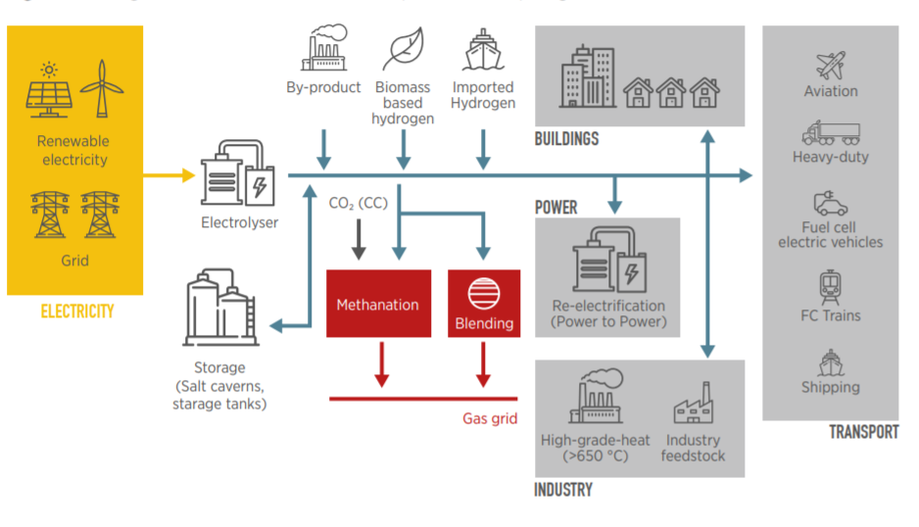
Green Hydrogen from Wind Energy - Opportunity
Hydrogen is a clean medium of transmission of energy
Hydrogen has numerous industrial uses and has an established demand
Scope of Solution: Facilitate the production of Green Hydrogen from excess & variable wind energy
Source: hydrogeneurope.eu
https://www.irena.org/-/media/Files/IRENA/Agency/Publication/2018/Sep/IRENA_Hydrogen_from_renewable_power_2018.pdf

Slide 5
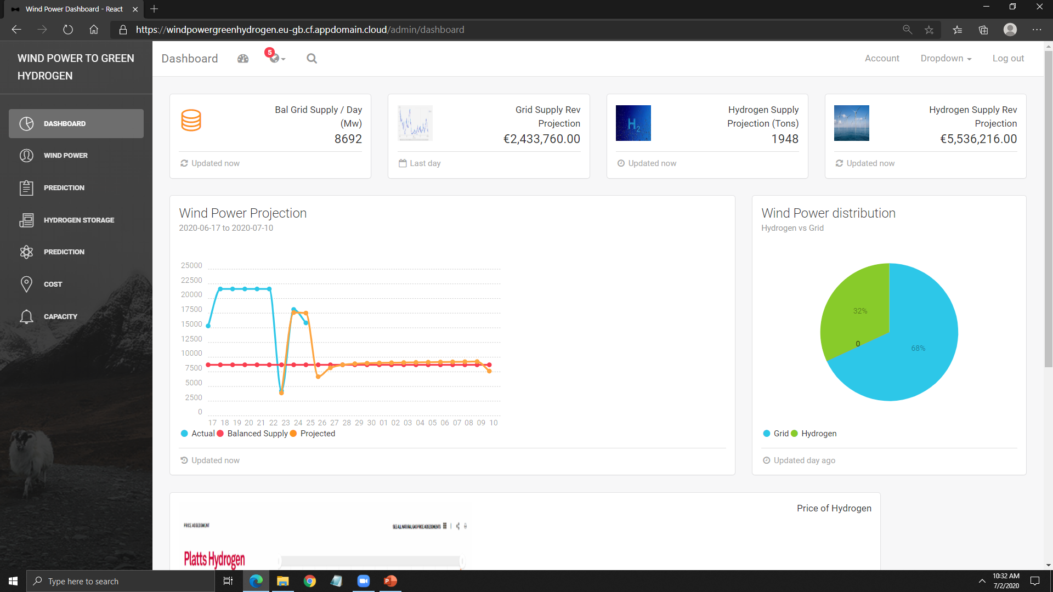
Solution – Wind Power to Green Hydrogen Dashboard
Objective:
Identify a stable target value of power supply for Grid transmission using percentile calculation
Provide forecast of green hydrogen production using excess energy above target
Solution:
Dashboard for Forecast of Power for Grid & Hydrogen production
https://windpowergreenhydrogen.eu-gb.cf.appdomain.cloud
Current Intended users:
Wind power producers
Solution Delivery:
Software as a service
Benefits:
Diversify revenue
Optimize revenue with right proportion of grid & hydrogen generation
More immune to grid problems
Reduce carbon foot print in production of hydrogen
Variable wind power allocation for Electrolysis
Hydrogen generation
Constant power supply target
Fixed wind power allocation for Grid

Slide 6








Solution Architecture
IBM Cloud
Wind power Historical Data
.csv data
www.Eliga.be
React App
Watson Studio
REST API
END
USER
DASHBOARD
BROWSER + react.js app
Cloud Foundry
Db2
Wind power Prediction
Source Code: https://github.com/Vidhya-Natarajan/WindPowerGreenHydrogen

Slide 7
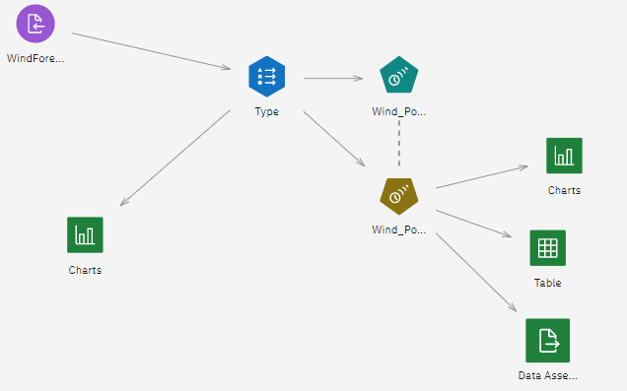
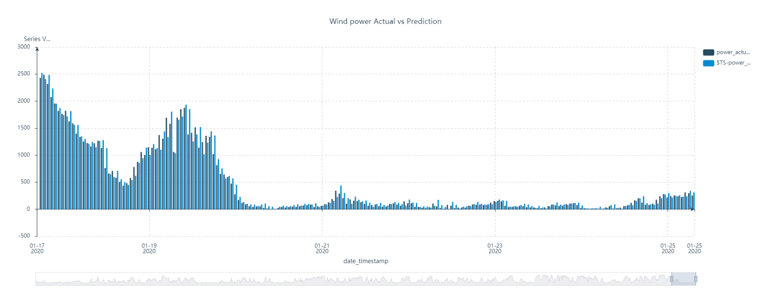
Wind Energy Prediction
Objective: Provide near term wind energy prediction with time series prediction
Approach: Use Watson SPSS modeler time series prediction to predict future values
Graph Source: IBM Watson SPSS modeler - Data Source: www.eliga.be

Slide 8
Current Solution Limitations & Assumptions
Adequate capacity of Electrolysers available for full conversion of excess power to hydrogen
Balanced power supply target @ 20% → (Power short fall @ 20% of instances in the period)
Hydrogen generation → 1Kg @ 45 Kwh
Hydrogen cost at market rate → 1Kg @ €2.8424 (Source: S&P Global Platts)
Grid Power cost → €0.284 € per Kwh (Belgium)
Fixed period for consideration (Jun-Jul 2020)
ML Model based on historical wind power
Manual process for wind energy prediction
Manual process for training model

Slide 9
Future Plans
Future Plans
Dashboard Improvements
End user configurable percentile values
Automated update of ML model with historic power prediction
Incorporate wind energy & hydrogen production variables in the ML model
Include price ML prediction of dynamic power & hydrogen
Dynamic model for hydrogen production & revenue calculation
Decision making for setting up hydrogen Infra
Generation
Storage
Distribution
Market place for hydrogen Producers, transporters, distributors & consumers
ML suggestion for Hydrogen producers, transporters, distributors & consumers in geographical area
Buying / Selling of hydrogen with contracting facility

Slide 10
Thank You

